Slide 1

Linear Models & Feature Engineering
?
Slides by:
Joseph E. Gonzalez jegonzal@cs.berkeley.edu

Slide 2
Recap

Slide 3
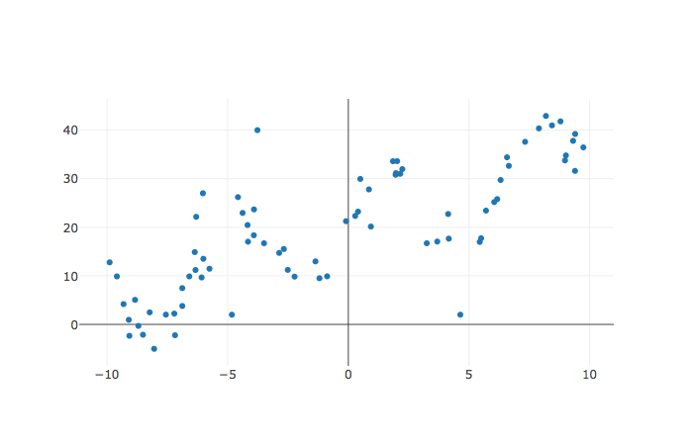
Machine
Modeling and Estimation (Learning)
Training Data
Define the model
Choose a loss
Minimize the loss
Y
X

Slide 4
Prediction (Testing)
Sometimes also called inference and scoring
Receive a new query point
Make prediction using learned model
Test Error (using squared loss)

Slide 5
Training
Objective
Idealized
Objective
Minimize our expected prediction error over all possible test points
Ideal Goal
Can’t be computed … ☹
But we can analyze it!
Minimize error on training data
sample of data from the world
estimate of the expected error
We can compute this directly

Slide 6
Analysis of Squared Error
Quantities in red are random variables
Training on a random sample of data from the population.
Testing at a given query point x and computing expected squared error
Expectation is taken over all possible Y observations.
Expectation is taken over all possible training datasets

Slide 7
In the last lecture we showed that
=
Obs. Var. +
(Bias)² +
Mod. Var.
Other terminology:
“Noise” +
(Bias)² +
Variance

Slide 8
In the last lecture we showed that
Assuming 0 mean observation noise and true function h(x)
=
Obs. Variance
“Noise”
(Bias)²
Model Variance

Slide 9
Alternative proof
Assuming 0 mean observation noise and true function h(x)
Courtesy of Allen Shen
Linearity of Expectation
Definition of Y
= 0
Defn’ of ϵ
Bonus study material!

Slide 10
Alternative proof
Assuming 0 mean observation noise and true function h(x)
Linearity of Expectation
Definition of Y
= 0
Defn’ of ϵ
Bonus study material!

Slide 11
Alternative proof
Y is independent of θ (only depends on noise)
Definition of Y
Linearity of expectation
Assuming 0 mean observation noise and true function h(x)
Bonus study material!

Slide 12
Alternative proof
Definition of Variance
Rearranging terms
Assuming 0 mean observation noise and true function h(x)
Bonus study material!

Slide 13
Summary
Expectation is taken over all possible Y observations.
Obs. Var. +
(Bias)² +
Mod. Var.
Expectation is taken over all possible training datasets

Slide 14
Bias =
The expected deviation between the predicted value and the true value
Depends on both the:
choice of f
learning procedure
Under-fitting
All possible functions
Possible θ values
Bias
True Function

Slide 15
Observation Variance =
the variability of the random noise in the process we are trying to model
measurement variability
stochasticity
missing information
Beyond our control (usually)

Slide 16
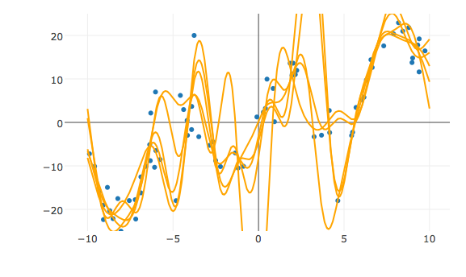
Estimated Model Variance =
variability in the predicted value across different training datasets
Sensitivity to variation in the training data
Poor generalization
Overfitting

Slide 17
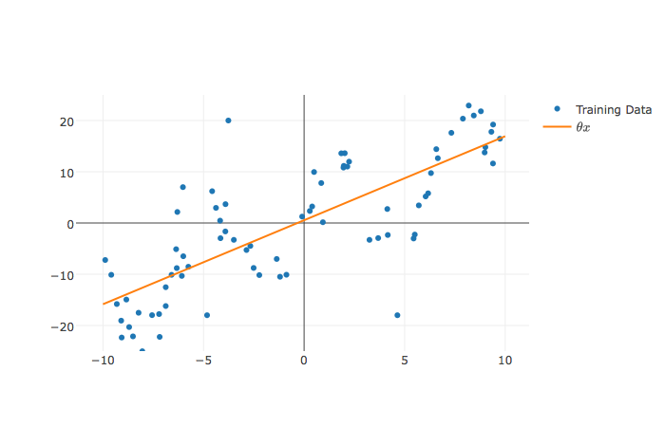
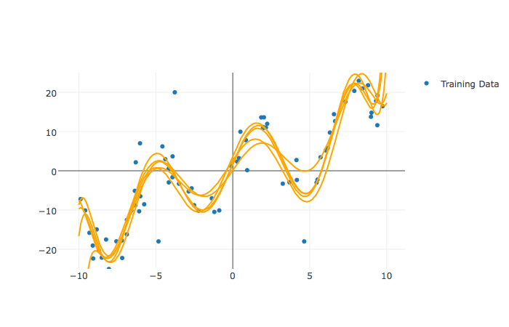
The Bias-Variance Tradeoff
Estimated Model Variance
We want to decrease both bias and variance but often decreasing one results in an increase in the other.
Bias

Slide 18
Bias Variance Plot
Test Error
Optimal Value
Test Error
Optimal Value
Variance
Variance
(Bias)²
Increasing Model Complexity
Notes:
Image

Slide 19
More Data supports More Complexity
Optimal Value
Test Error
Optimal Value
Test Error
Variance
Variance
(Bias)²
Increasing Model Complexity
Notes:
Image

Slide 20
Model Complexity
Roughly: capacity of the model to fit the data
Many different measures and factors
Covered in machine learning class
Dominant factors in linear models
Number and types of features
Regularization
Start with this
Return to this

Slide 21
Regression and Linear Models

Slide 22
Regression
Estimating relationship between X and Y
Y is a quantitative value
We will soon see X can be almost anything …
X
Domain
Y
Model

Slide 23
Least Squares Linear Regression
One of the most widely used tools in machine learning and data science
Model
Linear in the Parameters
Feature Functions
Squared Loss
Loss Minimization
We will return to solving this soon!

Slide 24
Linear Models and Feature Functions
Linear in the Parameters
Feature Functions
Designing the feature functions is a big part of machine learning and data science.
Feature Functions
capture domain knowledge
substantial contribute to expressivity (and complexity)

Slide 25
Linear Models and Feature Functions
Linear in the Parameters
Feature Functions
For Example:
Domain:
Model:
Designing the feature functions is a big part of machine learning and data science.
Feature Functions
capture domain knowledge
substantial contribute to expressivity (and complexity)
Features:
Adding a “constant” feature function
is a common method to introduce an offset (also sometimes called bias) term.

Slide 26
Linear Models and Feature Functions
Linear in the Parameters
Feature Functions
For Example:
Features:
← This is a linear model!
Linear in the parameters

Slide 27
Linear Models and Feature Functions
Linear in the Parameters
Feature Functions
For Example:
Features:
← This is a linear model!
Linear in the parameters

Slide 28
Linear Models and Feature Functions
Linear in the Parameters
Feature Functions
What if x is a record with numbers, text, booleans, etc…
X
Y
uid | age | state | hasBought | review
0 | 32 | NY | True | ”Meh.”
42 | 50 | WA | True | ”Worked out of the box …”
57 | 16 | CA | NULL | “Hella tots lit yo ...”
rating
2.0
4.5
4.1
Answer:
Feature engineering

Slide 29
Feature Engineering
How do we define 𝜙?
Keeping it ℝeal

Slide 30
Feature Engineering
The process of transforming the inputs to a model to improve prediction accuracy.
A key focus in many applications of data science
Feature Engineering enables you to:
capture domain knowledge (e.g., periodicity or relationships between features)
encode non-numeric features to be used as inputs to models
express non-linear relationships using linear models

Slide 31
Predict rating from review information
uid | age | state | hasBought | review
0 | 32 | NY | True | ”Meh.”
42 | 50 | WA | True | ”Worked out of the box …”
57 | 16 | CA | NULL | “Hella tots lit yo ...”
rating
2.0
4.5
4.1
Schema:
RatingsData(uid INTEGER, age FLOAT,
state STRING, hasBought BOOLEAN,
review STRING, rating FLOAT)

Slide 32
As a Linear Model?
RatingsData(uid INTEGER, age FLOAT,
state STRING, hasBought BOOLEAN,
review STRING, rating FLOAT)
uid | age | state | hasBought | review
0 | 32 | NY | True | ”Meh.”
42 | 50 | WA | True | ”Worked out of the box …”
57 | 16 | CA | NULL | “Hella tots lit yo ...”
rating
2.0
4.5
4.1
X=
Y=
Can I use X and Y directly in a linear model
No! Why?
Text, Categorical data, Missing values…
X
Domain

Slide 33
Basic Transformations
Uninformative features: (e.g., UID)
Is this informative (probably not?)
Transformation: remove uninformative features (why?)
Could increase model variance …
Quantitative Features (e.g., Age)
Transformation: May apply non-linear transformations (e.g., log)
Transformation: Normalize/standardize (more on this later …)
Example: (x – mean)/stdev
Categorical Features (e.g., State)
How do we convert State into meaningful numbers?
Alabama =1 , …, Utah = 50 ?
Implies order/magnitude means something … we don’t want that ...
Transformation: One-hot-Encode

Slide 34
One Hot Encoding (dummy encoding)
Transform categorical feature into many binary features:
state
NY
WA
CA
AK | … | CA | … | NY | … | WA | … | WY
0 | … | 0 | … | 1 | … | 0 | … | 0
0 | … | 0 | … | 0 | … | 1 | … | 0
0 | … | 1 | … | 0 | … | 0 | … | 0
Origin of the term: multiple “wires” for possible values one is hot …
Corresponding feature functions
Cat
Dog
See notebook for example code.
Fish

Slide 35
Encoding Missing Values
Missing values in Quantitative Data
Try to impute (estimate) missing values… (tricky)
Substitute the sample mean
Try more sophisticated algorithms to predict the missing value …
Add a binary field called “missing_col_name”. (why?)
Sometimes missing data is signal!
Missing values in Categorical Data
Add an addition category called “missing_col_name”
Some Boolean values can be converted into
True => +1, False => -1, Missing => 0

Slide 36
Encoding categorical data
Categorical Data ➔ One-hot encoding:
Text Data
Bag-of-words & N-gram models
“Learning about machine learning is fun.”
aardvark
machine
aardwolf
learning
zyzzyva
fun
Vector
0
0
…
1
…
2
…
1
…
0

Slide 37
Bag-of-words Encoding
Generalization of one-hot-encoding for a string of text:
Encode text as a long vector of word counts (Issues?)
Long = millions of columns →typically high dimensional and very sparse
Word order information is lost… (is this an issue?)
New unseen words at prediction (test) time → drop them …
A bag is another term for a multiset: an unordered collection which may contain multiple instances of each element.
Stop words: words that do not contain significant information
Examples: the, in, at, or, on, a, an, and …
Typically removed
“Learning about machine learning is fun.”
aardvark
machine
aardwolf
learning
zyzzyva
fun
Vector
0
0
…
1
…
2
…
1
…
0

Slide 38
I made this art piece in graduate school
Do you see the stop word?
There used to be a dustbin and broom
… but the janitors got confused …

Slide 39
N-Gram Encoding
Sometimes word order matters:
How do we capture word order in a “vector” model?
N-Gram: “Bag-of- sequences-of-words”
The book was not well written but I did enjoy it.
The book was well written but I did not enjoy it.

Slide 40
2-Gram Encoding
Removed stop words
The book was well written but I did not enjoy it.
book well
well written
written not
not enjoy
well written
not enjoy
written not
aardvark airlines
book well
apple pen
zyzzyva sf
Vector
0
0
…
1
…
1
…
1
…
1
…
0

Slide 41
N-Gram Encoding
Sometimes word order matters:
How do we capture word order in a “vector” model?
N-Gram: “Bag-of- sequences-of-words”
Issues:
Can be very sparse (many combinations occur only once)
Many combinations will only occur at prediction time → drop ..
Often use hashing approximation:
Increment counter at hash(“not enjoy”) collisions are okay
The book was not well written but I did enjoy it.
The book was well written but I did not enjoy it.

Slide 42
Feature Transformations to Capture Domain Knowledge
Feature functions capture domain knowledge by introducing additional information from other sources and/or combining features
Encoding non-linear patterns
Could do a database lookup
Diurnal patterns.

Slide 43
The Feature Matrix
Domain
DataFrame
uid | age | state | hasBought | review
0 | 32 | NY | True | ”Meh.”
42 | 50 | WA | True | ”Worked out of the box …”
57 | 16 | CA | NULL | “Hella tots lit...”
AK | … | NY | … | WY | age | hasBought | hasBought missing
0 | … | 1 | … | 0 | 32 | 1 | 0
0 | … | 0 | … | 0 | 50 | 1 | 0
0 | … | 0 | … | 0 | 16 | 0 | 1
Entirely Quantitative Values

Slide 44
The Feature Matrix
AK | … | NY | … | WY | age | hasBought | hasBought missing
0 | … | 1 | … | 0 | 32 | 1 | 0
0 | … | 0 | … | 0 | 50 | 1 | 0
0 | … | 0 | … | 0 | 16 | 0 | 1
Domain
Entirely Quantitative Values
n
Rows of the 𝚽 matrix correspond to records.
=
=
DataFrame
Columns of the 𝚽 matrix correspond to features.
d
uid | age | state | hasBought | review
0 | 32 | NY | True | ”Meh.”
42 | 50 | WA | True | ”Worked out of the box …”
57 | 16 | CA | NULL | “Hella tots lit...”

Slide 45
Making Predictions
AK | … | NY | … | WY | age | hasBought | hasBought missing
0 | … | 1 | … | 0 | 32 | 1 | 0
0 | … | 0 | … | 0 | 50 | 1 | 0
0 | … | 0 | … | 0 | 16 | 0 | 1
Entirely Quantitative Values
n
Domain
Rows of the 𝚽 matrix correspond to records.
=
=
DataFrame
Columns of the 𝚽 matrix correspond to features.
d
Prediction
=
=
uid | age | state | hasBought | review
0 | 32 | NY | True | ”Meh.”
42 | 50 | WA | True | ”Worked out of the box …”
57 | 16 | CA | NULL | “Hella tots lit...”

Slide 46
Summary of Notation
Domain
Feature Engineering
Linear
Regression

Slide 47
Optimizing the Loss (Bonus Material)
Taking the Gradient of the loss

Slide 48
Optimizing the Loss (Bonus Material)
Deriving the Normal Equation
Rule 1
Rule 2
Useful Matrix Derivative Rules:
Taking the Gradient of the loss
(1)
(2)
Setting the gradient equal to 0 and solving for θ:
“Normal Equation”

Slide 49
The Normal Equation
n
d
n
1
-1
d
=
d
Note: For inverse to exist 𝚽 needs to be full column rank.
→ cannot have co-linear features
This can be addressed by adding regularization …
In practice we will use regression software (e.g., scikit-learn) to estimate θ

Slide 50
Geometric Derivation (Bonus Material)
Examine the column spaces:
Columns space of 𝚽
n
n
d
1
Linear model → Y is a linear combination of columns 𝚽

Slide 51
Geometric Derivation (Bonus Material)
Examine the column spaces:
Columns space of 𝚽
n
n
d
1
Linear model → Y is a linear combination of columns 𝚽

Slide 52
Geometric Derivation (Bonus Material)
Examine the column spaces:
Columns space of X
n
n
p
1
Linear model → Y is a linear combination of columns X
Ŷ is in the subspace spanned by the columns of 𝚽
Y
Definition of orthogonal
(Y – 𝚽θ)
Subspace spanned by 𝚽¹ and 𝚽²
𝚽¹
Normal to subspace
Spanned by 𝚽
𝚽θ
Normal
Equations
𝚽²
“Normal Equation”

Slide 53
Least Squares Regression in Practice
Use optimized software packages
Address numerical issues with matrix inversion
Incorporate some form of regularization
Address issues of collinearity
Produce more robust models
We will be using scikit-learn:
http://scikit-learn.org/stable/modules/linear_model.html
See Homework 6 for details!

Slide 54
Daily Quiz
http://bit.ly/ds100-sp18-lin
Which of the following are not linear models:
(A)
(B)
(C)
(D)

Slide 55
Notebook Demo

Slide 56
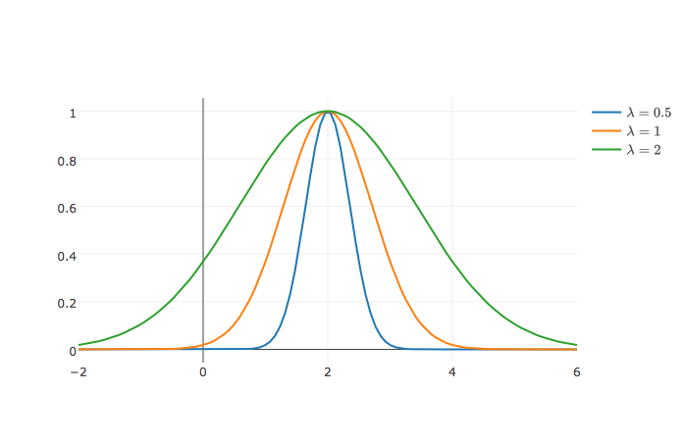
Generic Features: increase model expressivity
Gaussian Radial Basis Functions:
Gaussian RBF

Slide 57
Training Error
Impressive!

Slide 58
Training vs Test Error
Failure to Generalize!
Impressively
Bad! ☹

Slide 59
Training vs Test Error
← Underfitting
Overfitting →
Best Fit
Test Error
Error
Training Error
Model “complexity”
(e.g., number of features)

Slide 60
Generalization: The Train-Test Split
Training Data: used to fit model
Test Data: check generalization error
How to split?
Randomly, Temporally, Geo…
Depends on application (usually randomly)
What size? (90%-10%)
Larger training set → more complex models
Larger test set → better estimate of generalization error
Typically between 75%-25% and 90%-10%
Train - Test
Split
Train
Data
Test
You can only use the test dataset once after deciding on the model.

Slide 61
Generalization: Validation Split
Training Data: used to fit model
Test Data: check generalization error
How to split?
Randomly, Temporally, Geo…
Depends on application (usually randomly)
What size? (90%-10%)
Larger training set → more complex models
Larger test set → better estimate of generalization error
Typically between 75%-25% and 90%-10%
V
Train - Test
Split
Validation
Split
Train
Train
V
Train
Train
V
Train
Data
V
Train
Validate Generalization
V
5-Fold
Cross Validation
Test
Cross validation simulates multiple train test-splits on the training data.
You can only use the test dataset once after deciding on the model.

Slide 62
Returning to Regularization

Slide 63
Regularization Parametrically Controlling the Model Complexity
𝜆
Tradeoff:
Increase bias
Decrease variance

Slide 64
Basic Idea of Regularization
Penalize
Complex Models
Fit the Data
Regularization Parameter
How should we define R(θ)?
How do we determine 𝜆?

Slide 65
Common Regularization Functions
Ridge Regression (L2-Reg)
LASSO
(L1-Reg)
Distributes weight across related features (robust)
Analytic solution (easy to compute)
Does not encourage sparsity → small but non-zero weights.
Encourages sparsity by setting weights = 0
Used to select informative features
Does not have an analytic solution → numerical methods
Notes:
Least Absolute Shrinkage and Selection Operator

Slide 66
Regularization and Norm Balls
Loss
𝜃₂
𝜃_{opt}
𝜃₁

Slide 67
Regularization and Norm Balls
Loss
Loss
Loss
𝜃₂
𝜃₂
𝜃_{opt}
𝜃₂
𝜃_{opt}
𝜃_{opt}
Snaps to
corners
Snaps to
corners
𝜃₁
𝜃₁
𝜃₁
Weight sharing
Sparsity
inducing
Compromise…
Two parameters …
L2 Norm (Ridge)
L1 Norm (LASSO)
L1 + L2 Norm
(Elastic Net)
Notes:
- Note the isosurfaces for the various Lp norms - the L1 isosurface shows why any increase in value of any parameter has to be offset by an equal decrease in the value of another.

Slide 68
Determining the Optimal 𝜆
Test Error
Optimal Value
Validation Error
(Bias)²
Error
How do we determine 𝜆?
Variance
Increasing 𝜆
Value of 𝜆 determines bias-variance tradeoff
Larger values → more regularization → more bias → less variance
Determined through cross validation

Slide 69
Standardization and the Intercept Term
Height = θ₁ age_in_seconds + θ₂ weight_in_tons
Regularization penalized dimensions equally
Standardization
Ensure that each dimensions has the same scale
centered around zero
Intercept Terms
Typically don’t regularize intercept term
Center y values (e.g., subtract mean)
Small
Large
Standardization
For each dimension k:

Slide 70
Regularization and High-Dimensional Data
Regularization is often used with high-dimensional data
d
d
𝚽
Tall Skinny Matrix
𝚽
High-dimensional sparse matrix
n
n >> d
typically dense
Regularization can help with complex feature transformations
n
d > n
requires regularization
Goal: to determine informative dimensions
Consider L1 Regularization. Why?
Goal: is to make robust predictions
Consider L2 (+L1) Regularization

